Slide 1

Gold Bank
Implementing Bitcoin into Online Banking
By: Jonathan Reisman
02/01/2020

Slide 2
Agenda
Business Industry & Context
Business Context: Gold Bank
User Persona
Proposal
Expected Cost of Implementation
Financial Impact to the Business
Requirement Statements
Mobile App Sketches
Agile Methodology
Stakeholders
Schedule
Risks
Questions

Slide 3
Bitcoin Industry & Context
Bitcoin is a decentralized digital currency that utilizes peer-to-peer technology to facilitate instant payments.*
Bitcoin is not regulated in the United States.
Acquiring licenses necessary to buy/ sell bitcoin can be difficult and time consuming.
Key fintech and financial institutions associated with cryptocurrency include Square, Inc., Facebook, and JP Morgan Chase.
Top performing asset of the decade (gains of over 9,000,000% since July, 2010).*

Slide 4
Business Context: Gold Bank
Gold Bank is a regional bank located primarily in the Northeast
Looking to be first to market in offering a bitcoin buying and selling platform
Foot traffic at branches decreased by 8% YoY, paving the way for a digital society
Revenue for 2019: $4.5B, but seeking to reach $7.5B in revenue by 2025

Slide 5
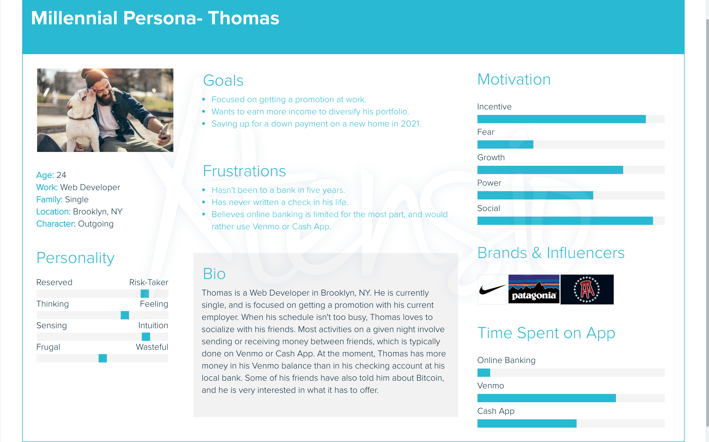

Slide 6
Proposal
The primary objective is to create a Bitcoin buying/ selling platform through online/ mobile banking.
Targeted demographic: millennials, and young professionals.
According to a study, 48% of the 18-34 age group think most people will be using Bitcoin in 10 years.*
Gold Bank reaching $1B in yearly Bitcoin sales by 2023, would help the bank reach its ultimate goal of $7.5B+ in revenue by 2025.

Slide 7
Expected Cost of Implementation
Cost of nation- wide licensing fee: $175,000, + annual payment of $135,000
Cost of technology, and legal counsel: $150,000
Full- Time backend developer: $100,000
Android developer: $144,000
IOS developer: $125,000
QA engineer: $80,000
Project Manager: $100,000
Initial working capital of 250 Bitcoin: $2.2m
Total cost for project employees: $549,000
Total cost for licensing, counsel, and technology: $325,000 + $135,000 annual

Slide 8
Financial Impact to the Business
1% commission fee for all purchases: $500M in purchases -> $5M expected revenue in 2021
Bank will also sell hardware wallets for clients to safely and securely store their Bitcoin ($50 per wallet)
Expected sales year 1 for the wallets: 2,000 units sold for $100,000 total
Most importantly, by offering Bitcoin and appealing to young professionals, the Bank will be more likely to acquire full relationships.

Slide 9
Requirement Statements
The online/mobile banking software should have an add- on tab dedicated to Bitcoin.
The system should have informational videos for clients to learn more about the technology.
The system should have a live help option to assist those who need further assistance.
The system should allow users to safely buy/sell Bitcoin.
The system should trigger a 1% commission fee for all purchases.
The Bitcoin add- on should be created and implemented by January 1st, 2021.

Slide 10
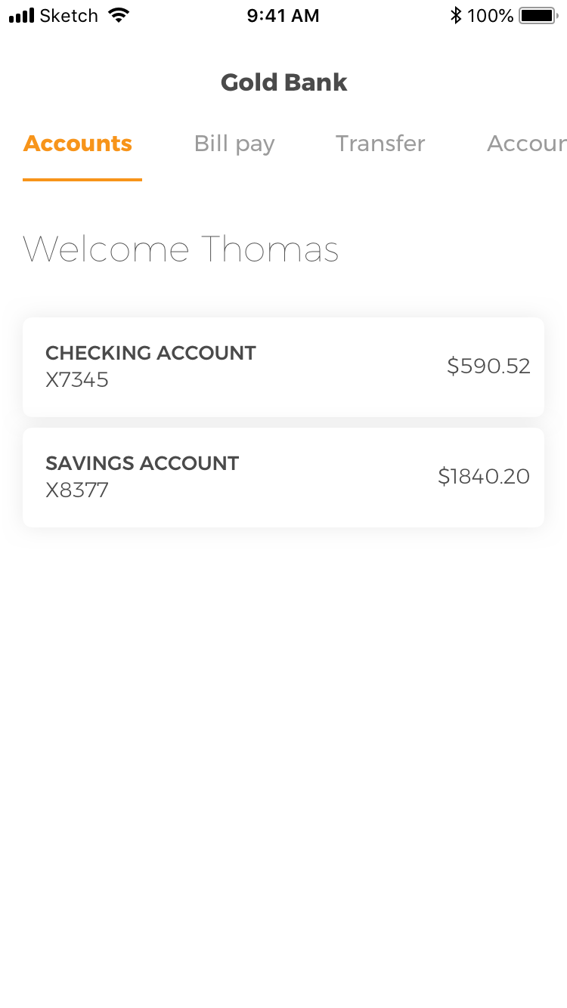
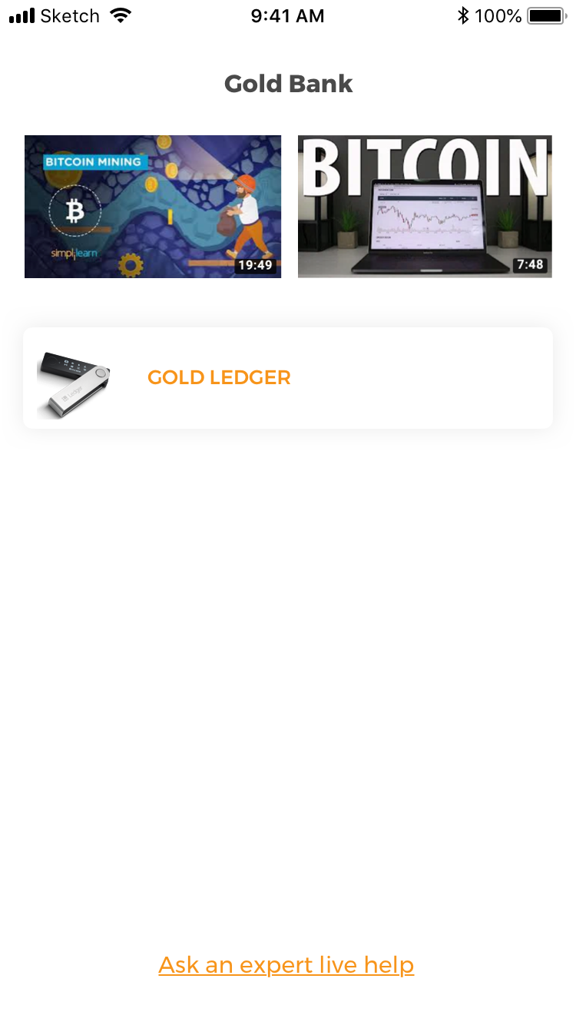
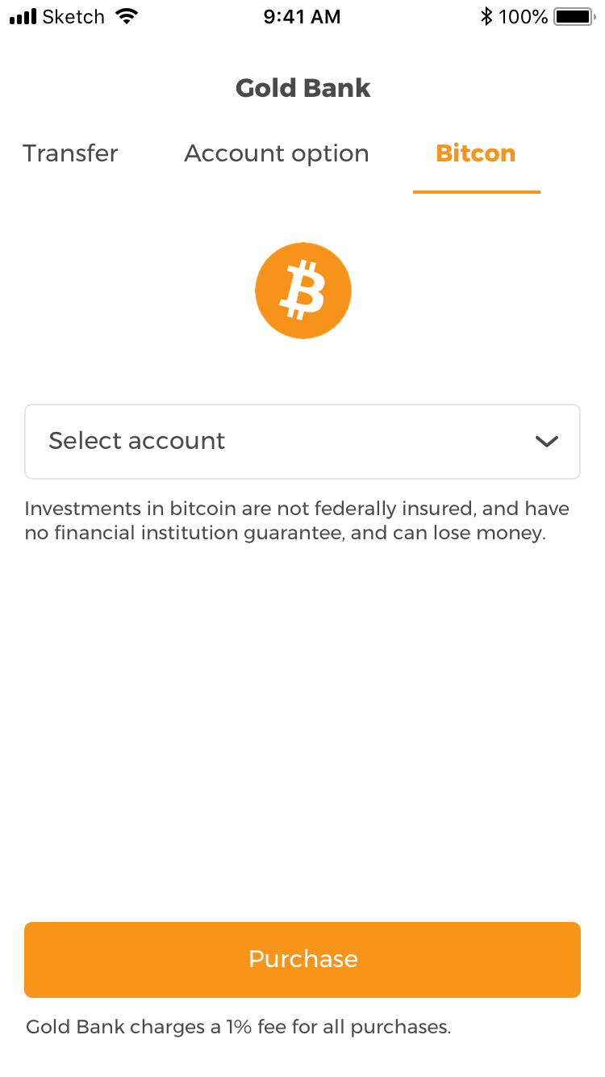
Mobile App Sketches

Slide 11
Agile Methodology
Flexibility is vital for the evolving cryptocurrency market
Promotes better communication between team members
Responding to client feedback on a frequent basis to create enhanced versions

Slide 12
Stakeholders
Clients (Existing, Prospects)
Media
Existing Bitcoin exchanges
Bank Employees
IOS Developer
Android Developer
Project Manager
Backend Developer
QA Engineer
Federal government

Slide 13
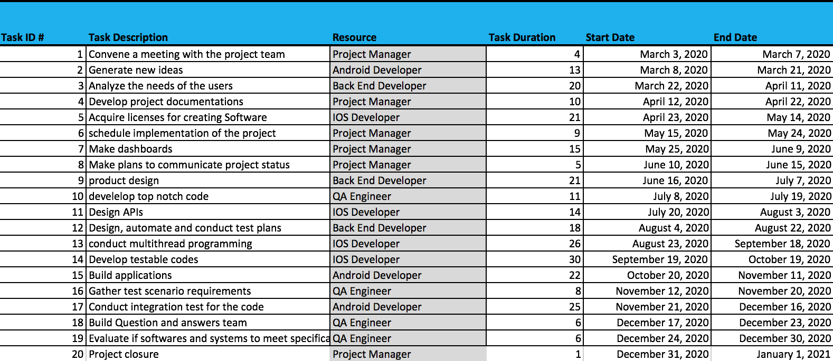
Schedule

Slide 14
Risks
Volatility of market could lead to angry clients
Regulation expected in near feature, so dynamic of cryptocurrency may change
Reputation
Negative media coverage
Coin security (hacking prevalent)
Money laundering

Slide 15
Questions?

